Slide 1

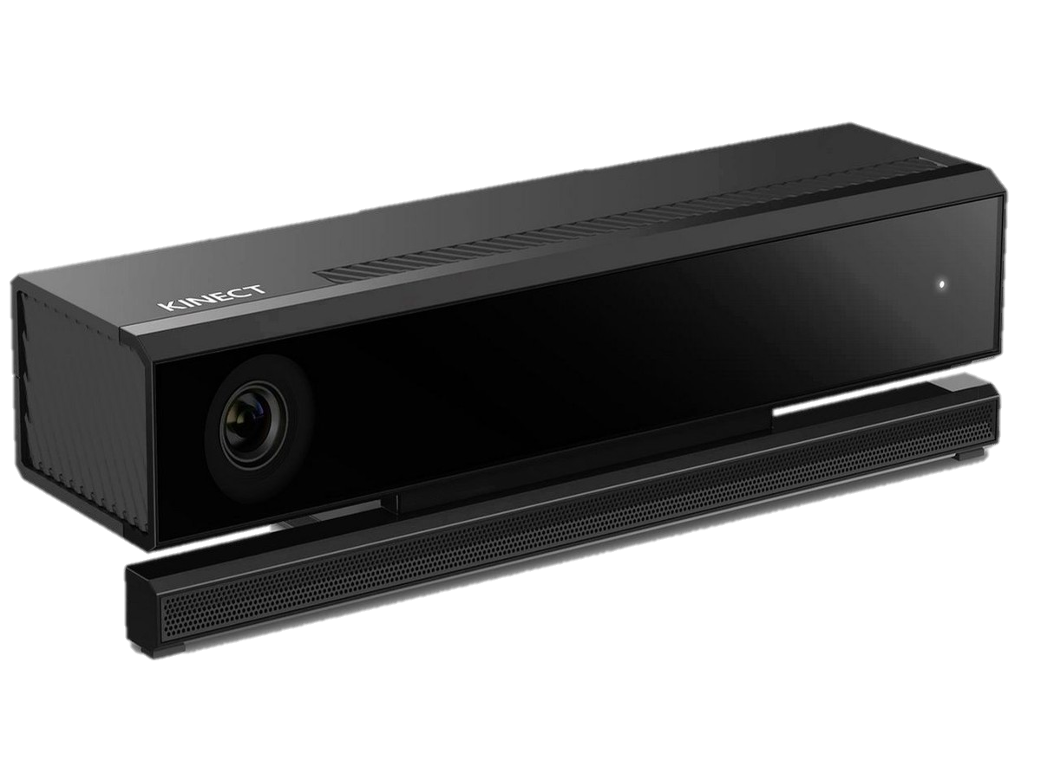
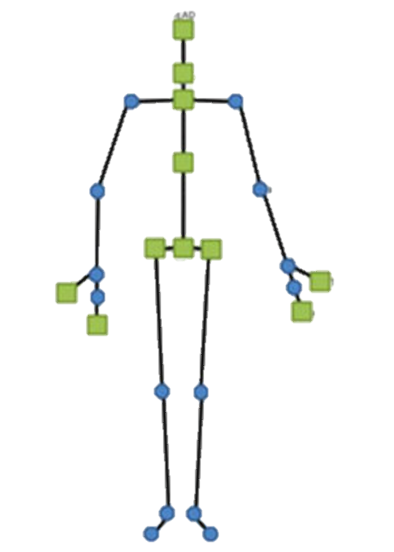
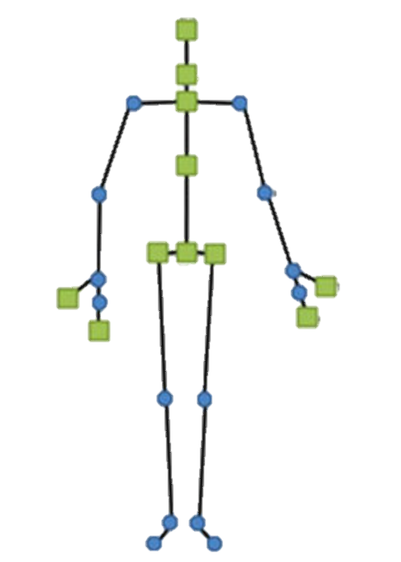

Obtain joint of interest
Capture Local Timestamp
Send to Signal Correction Unit
3D position
Posture estimation
Compute Sagittal and Flex angle
Completed
Requires Refinement
Vicon
Send to Feedback Display
Not yet Implemented

Slide 2
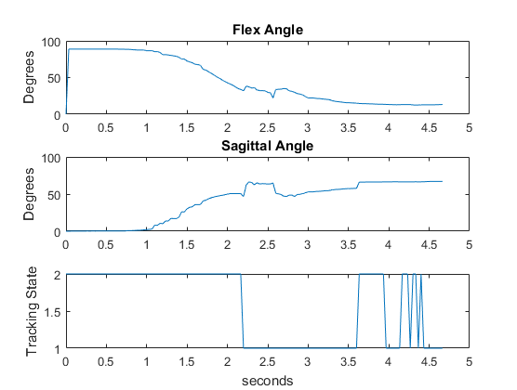
Test – Flexion of Body at 30 Degrees
2 – Tracked
1 - Inferred

Slide 3

Render Initial View
Standby
Tracked Body?
No
Yes
Visual Gesture Builder
Compute Sagittal & Flex Angle
Gesture Database
Kinect Studio
Recorded Clips
Error?
No
Update Message
Parse Error Code
Completed
Requires Refinement
Update Error Message
Go back to standby
Not yet Implemented

Slide 4
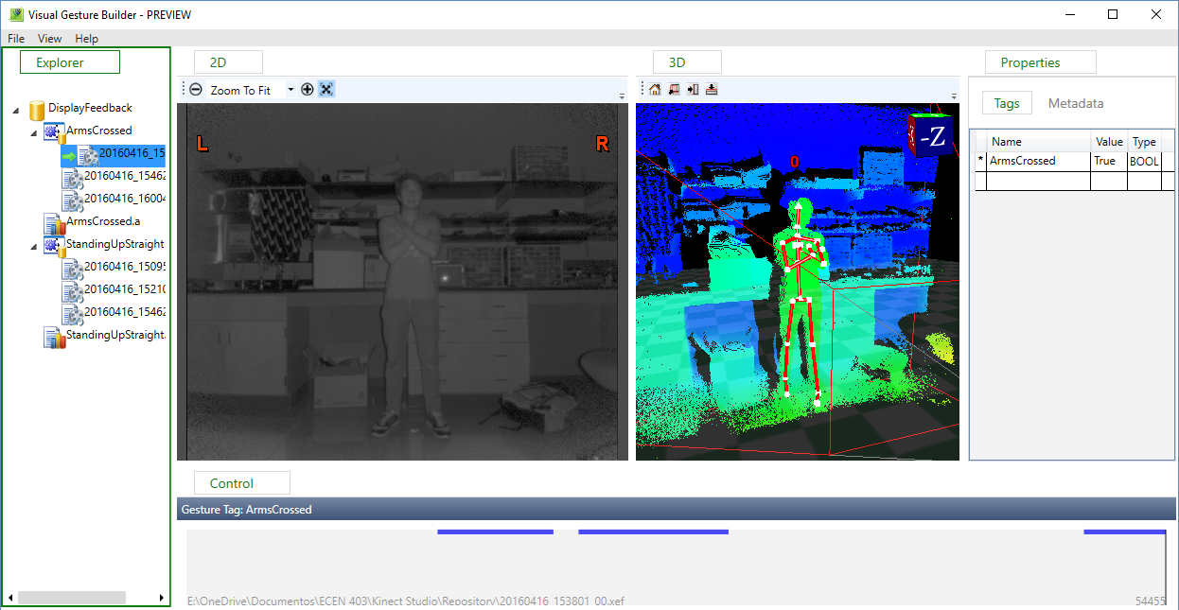

Slide 5
Send to Signal Correction Unit
Obtain joint of interest
3D position
Posture estimation
Completed
Compute Sagittal and Flex angle
Requires Refinement
Vicon
Not yet Implemented
Send to Feedback Display

Slide 6
Render Initial View
Standby
Tracked Body?
No
Yes
Completed
Requires Refinement
Compute Sagittal & Flex Angle
Not yet Implemented
Gesture Database
Error?
No
Update Message
Update Error Message
Go back to standby

